Slide 1

Marriages and Civil Partnerships – Online Booking Calendar

Slide 2
The Department of Immigration & Home Affairs is pleased to announce further enhancements to its online services with the introduction of an Online Booking Calendar for marriages and civil partnerships officiated in Gibraltar.
Couples may now peruse available dates for their special day from the comfort of their own homes using the link available in our website www.gibraltar.gov.gi

Slide 3
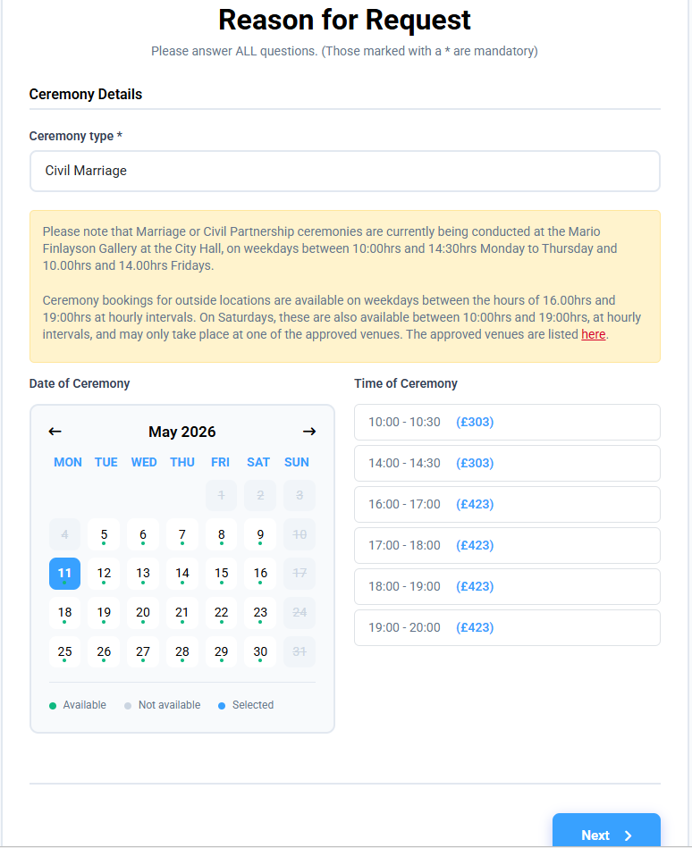
Couples can select their ceremony type and preferred date and time

Slide 4
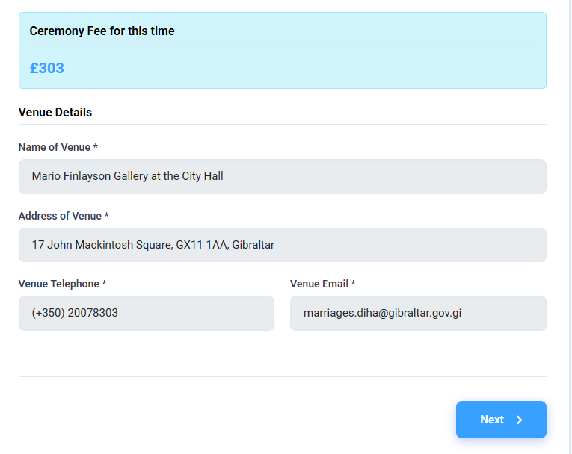
Relevant fee will be applied depending on the ceremony selection
Venue information will update automatically with City Hall details where applicable

Slide 5
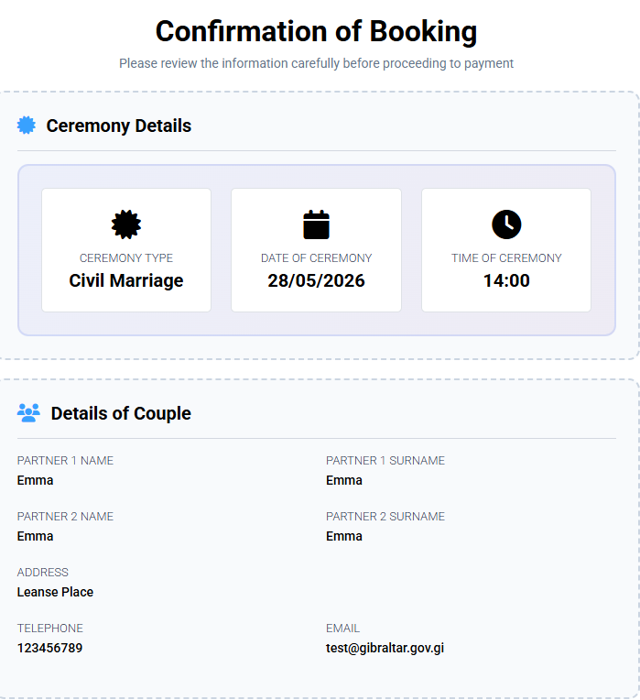
Customers will receive a Confirmation of Booking before payment of the relevant fee is required

Slide 6
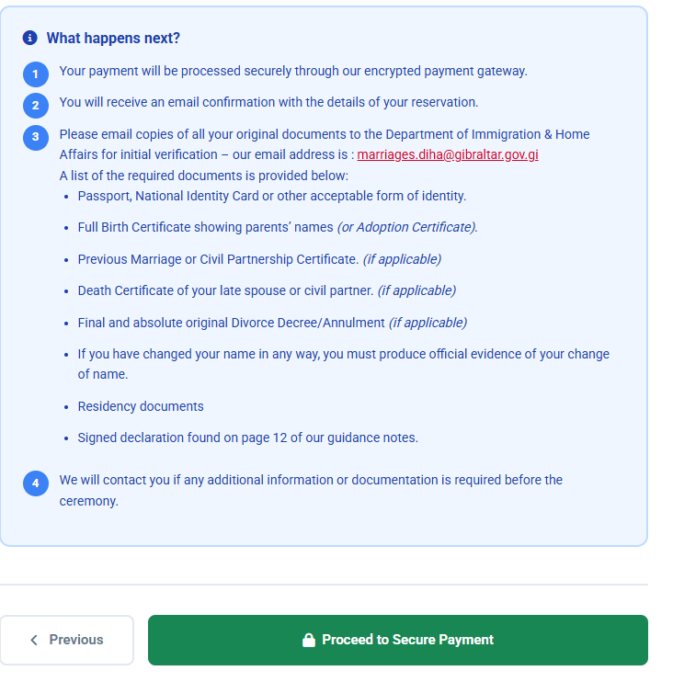
What happens next?

Slide 7
Payment will be processed through our secure encrypted payment gateway

Slide 8
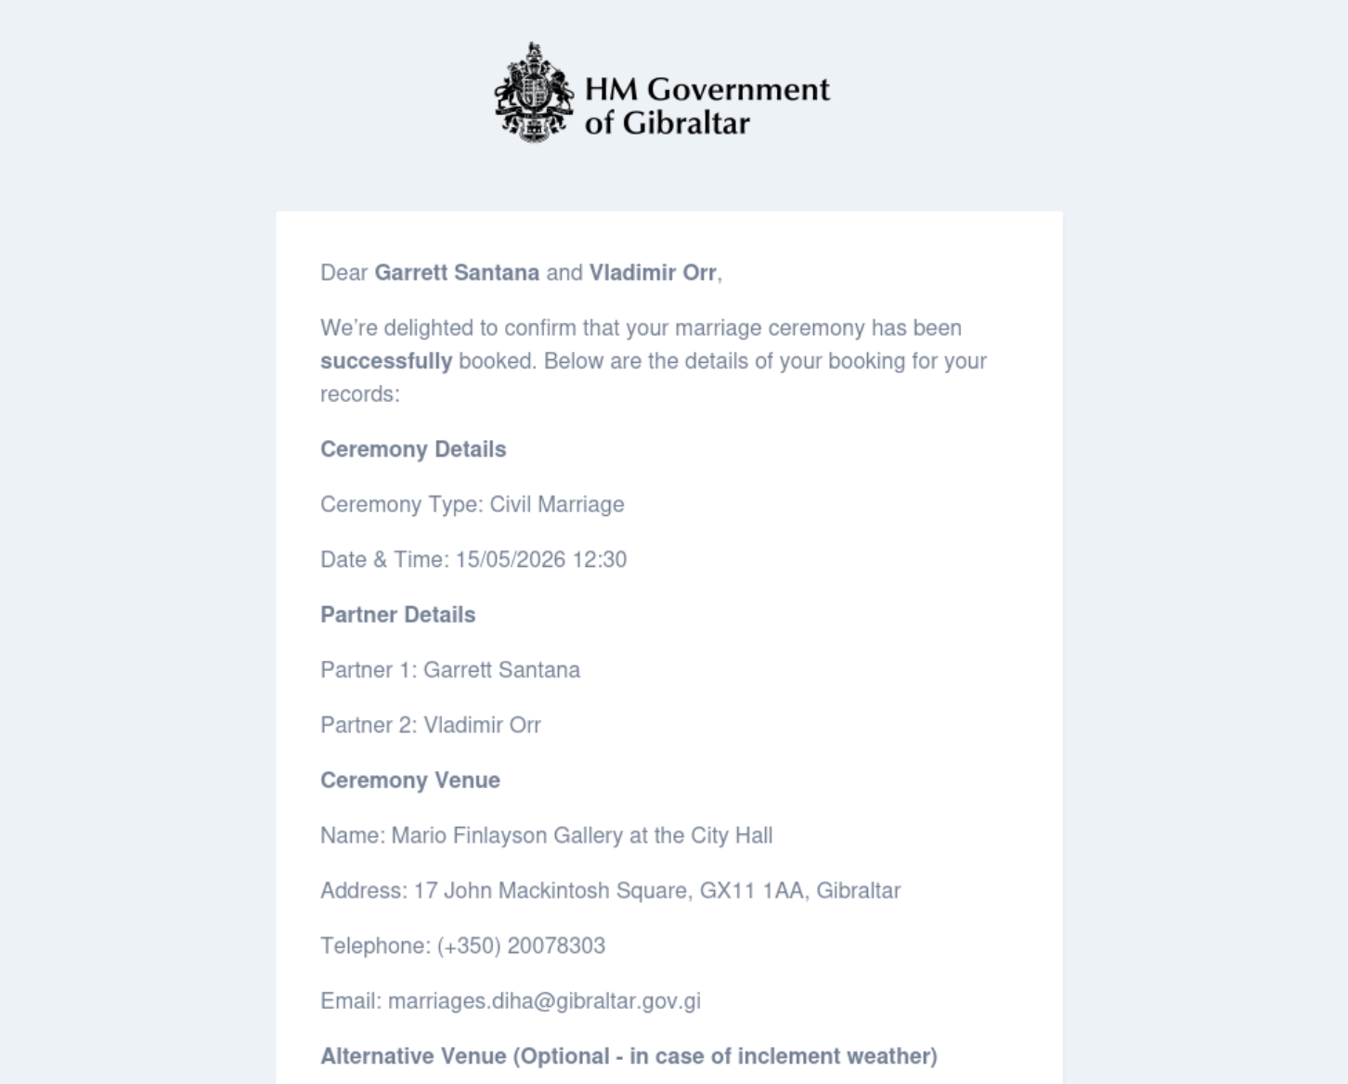
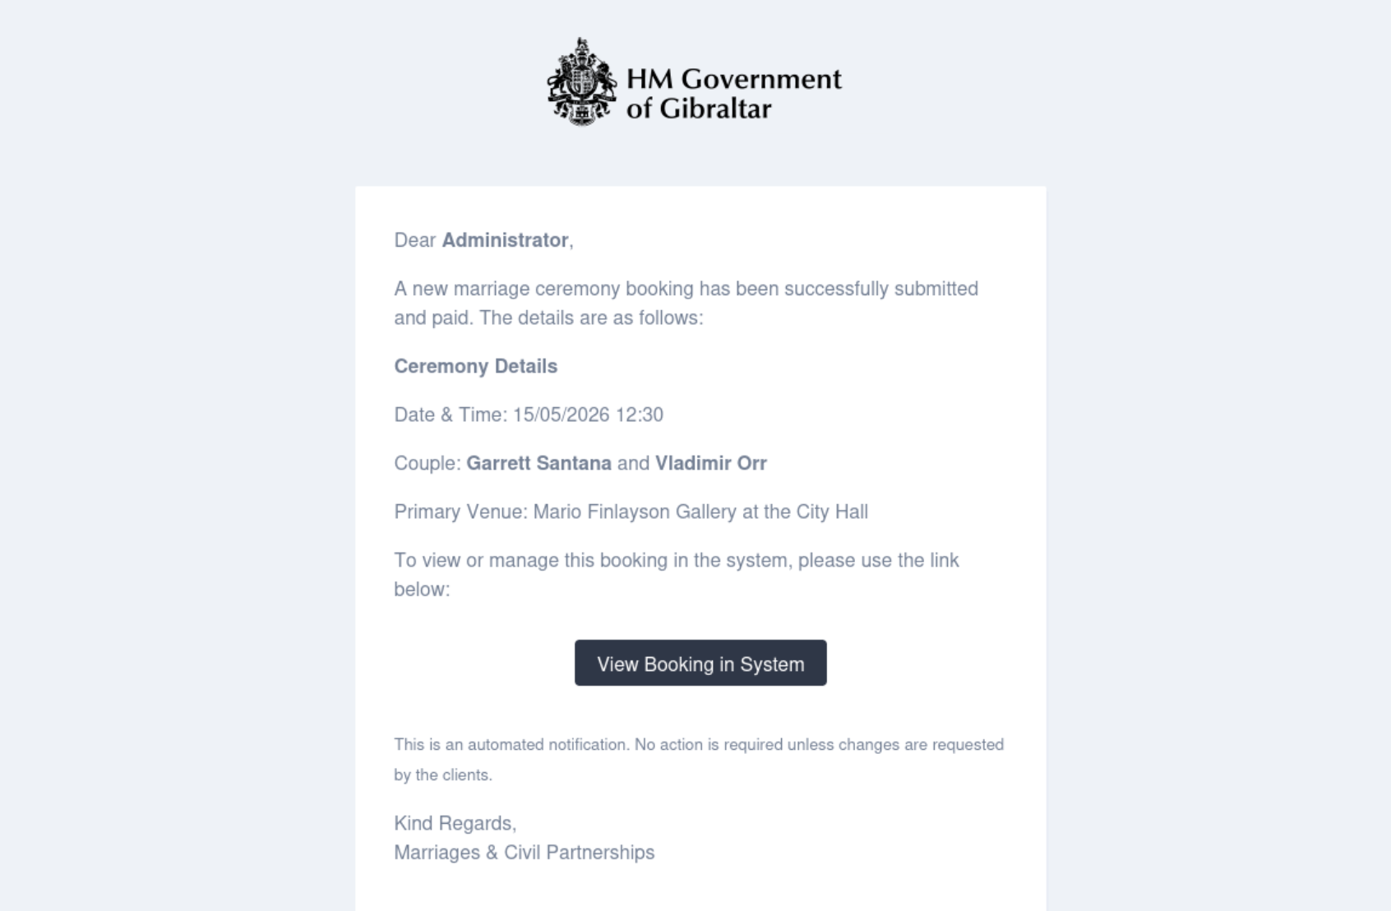
Couples will receive a confirmation email informing them that their ceremony has been successfully booked. A similar email will be sent to the Marriage Team

Slide 9
www.gibraltar.gov.gi – Department of Immigration & Home Affairs

