Slide 1

Eastside Sewage Transfer Scheme (ESTS)
Phase 4
Transport Road Section
Ministry of Transport – Press Call

Slide 2

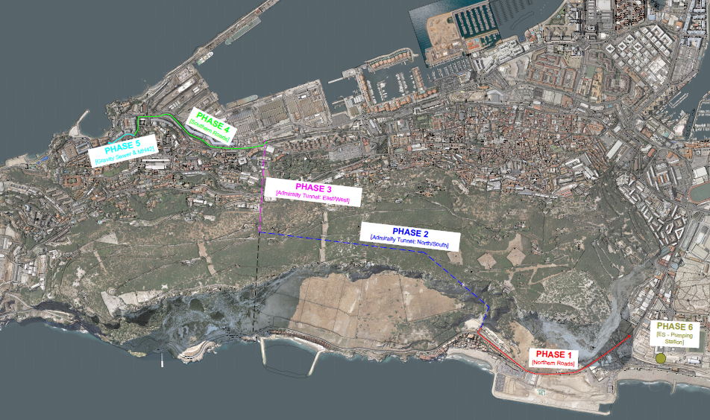
ESTS - Overview

Slide 3
ESTS - Overview
What is the ESTS?
• A new 3.8 km long, twin pumping main designed to safely carry sewage from the sewage pumping station in Eastside Kingsway roundabout area up to the main trunk sewer at Rosia Parade in the south.
• The route involves a combination of buried pipelines along roads and surface mounted pipelines running inside ex-MOD tunnels (Admiralty North-South and Admiralty East-West tunnels).
• The system consists of twin pipes of 450mm and a 355mm diameter respectively.
• Four additional pumps will be installed to cope with future sewage flows
As part of ESTS – Phase 6
To date – Over 100m of the 875m has been laid in Phase 1 (Eastside)

Slide 4
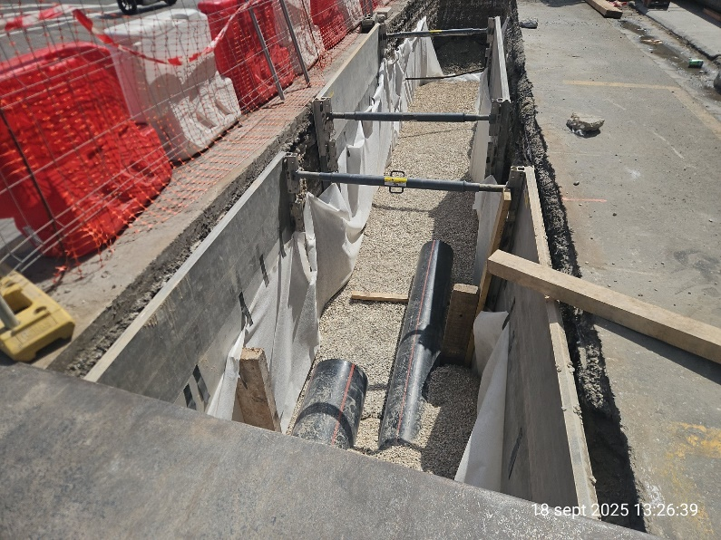
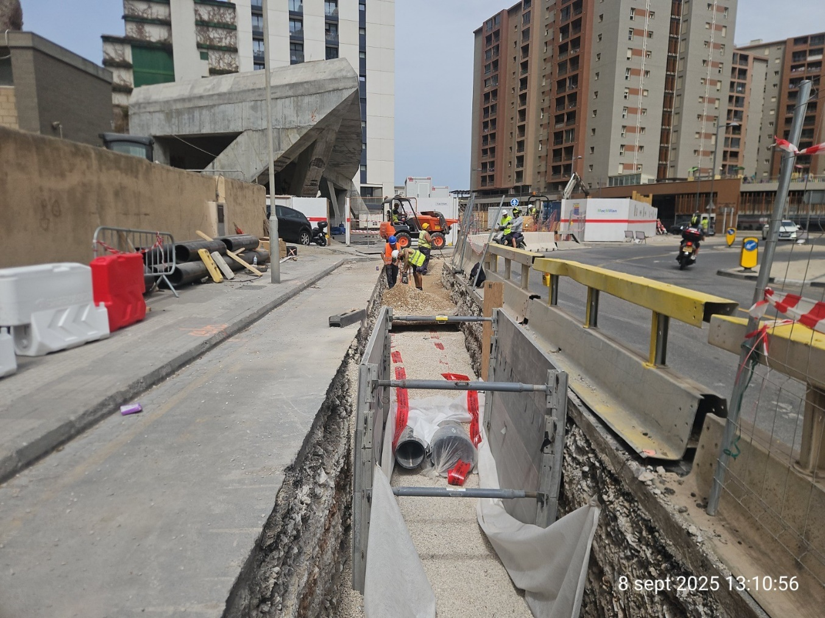
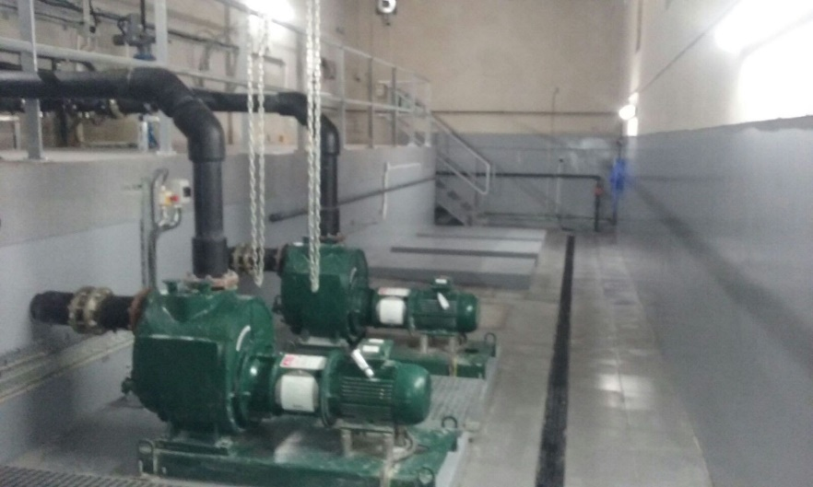
ESTS - Overview
Pumping Station
355mm
450mm

Slide 5
ESTS PHASE 4 – Key Details
ESTS - Phase 4
  Divided into 8 smaller stages.
  Total of 808m of dual pipes (355mm & 450mm) for Phase 4.
  From Saluting Battery (exercise park) → Rosia Road → Transport Road down South Pavilion Rd discharging at Rosia Parade.
Contractor = GJBS
  £1.88m contract
  Entire duration of Phase 4 = 1 year
Start on site = Sat 4th October 2025
Transport Road Section (ESTS Phase 4)
Duration of this phase of works = 12 Weeks
Total length of pipe for this section = 98m
Avg excavation depth 2.4m
Avg trench width 2m

Slide 6
Impacts of Phase 4 – Transport Road
Traffic Flow
Parking
Bus Routes

Slide 7
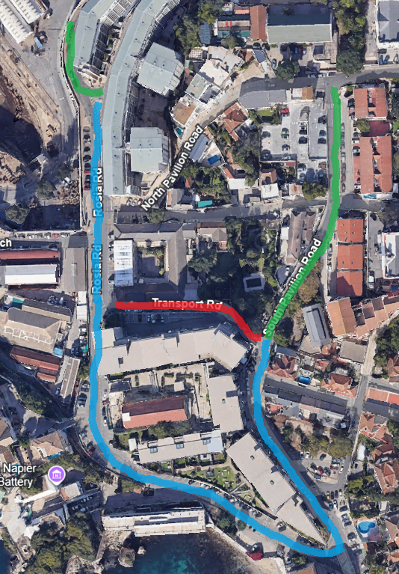

Impacts of Phase 4 – Transport Road
Traffic Flow
Traffic coming down South Pavilion Road will continue down to Rosia Road and Rosia Bay.
Traffic coming up Cumberland Road will not be able to continue towards Rosia Bay.
Traffic coming from Nelson’s View and Rosia Bay Area will not be able to go up South Pavilion Road and will be diverted along Rosia Road.
CLOSED REVERSE FLOW UNCHANGED

Slide 8
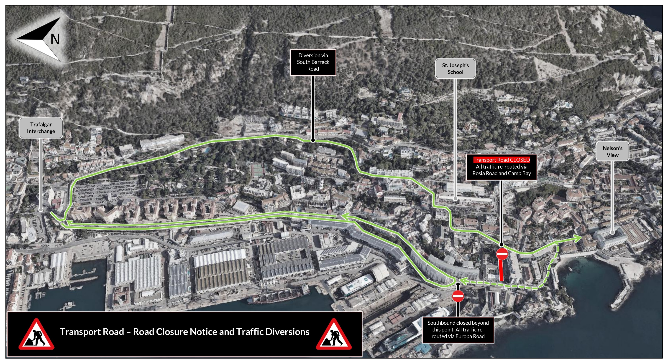

Slide 9
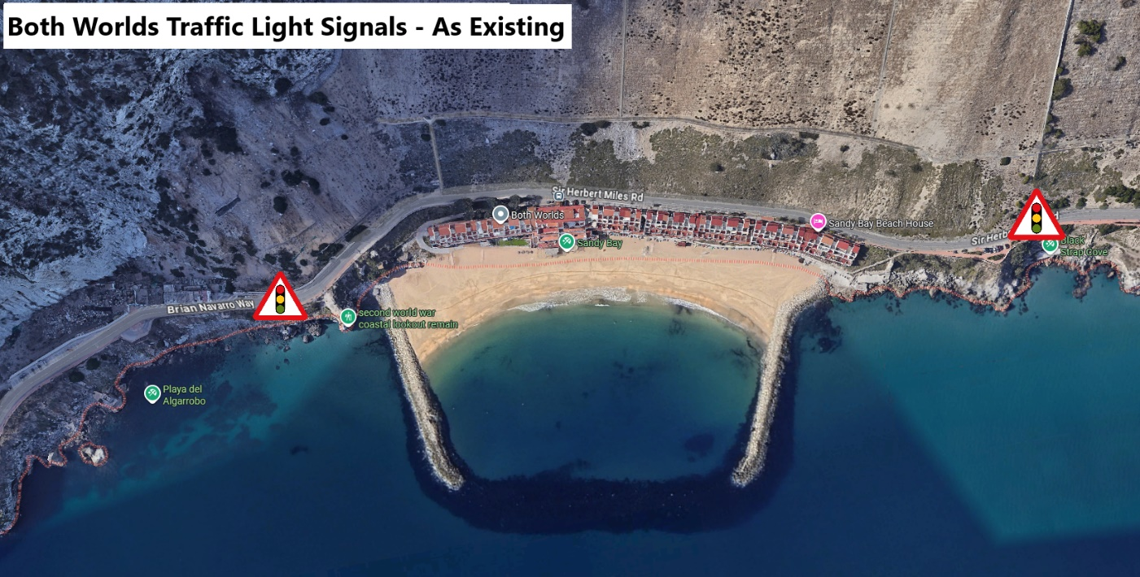
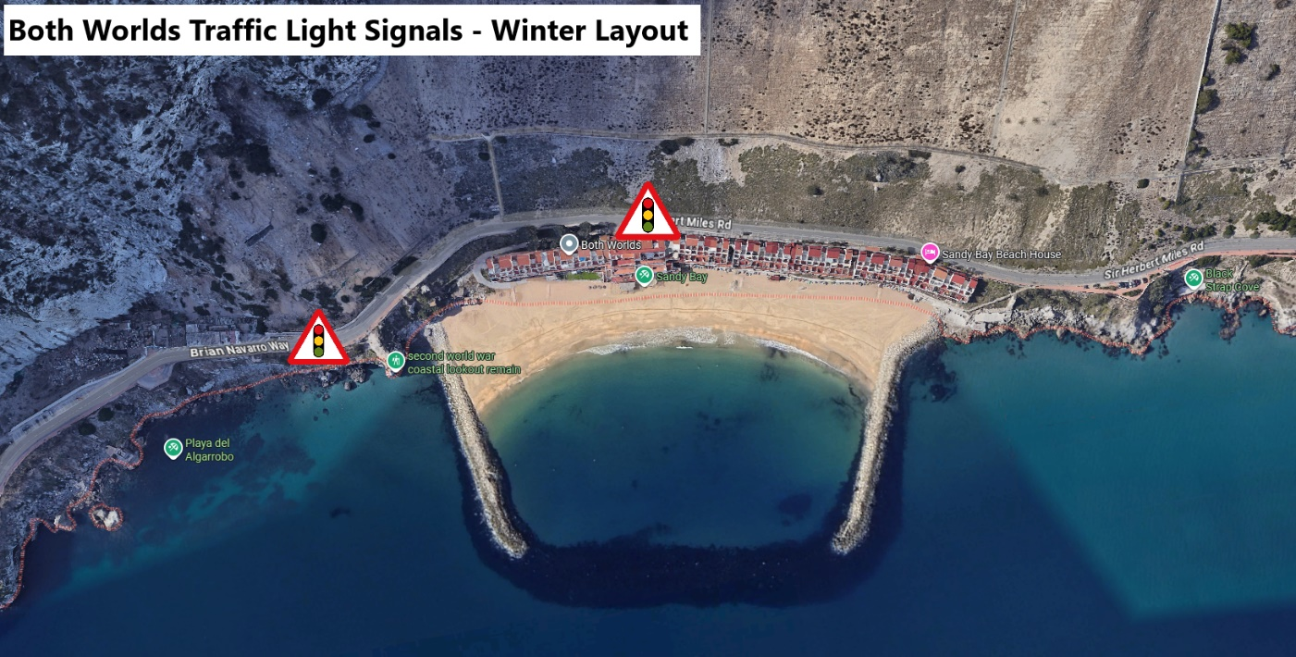

Impacts of Phase 4 – Transport Road
Traffic Flow – Both Worlds Traffic Lights
Both Worlds traffic light signals will be reduced in length (old winter schedule) to improve the bus route and schedule timings. Strictly no parking will be allowed on Sir Herbert Miles Road. The parking spaces will return for the 2026 summer season.

Slide 10
Impacts of Phase 4 – Transport Road
Traffic Flow
Parking
Bus Routes

Slide 11
Parking
Impacts of Phase 4 – Transport Road
Parking will temporarily lost for the duration of the works at;
Transport Road.
Parking Bays on Rosia Road (opposite Cumberland Road)
5 Parking spaces in front of Bayview and Clock Tower (for temporary bus shelter)

Slide 12
Parking
Impacts of Phase 4 – Transport Road
Due to change in traffic flow direction, parked vehicle orientation needs to be corrected.
On 4th October, temporary parking restrictions will be put in place in these areas to allow for implementation of new traffic flow and allow vehicles to park in the correct direction.
The restrictions in these areas will be for a number of hours on the 4th October and will be removed as soon as all vehicles are cleared.

Slide 13
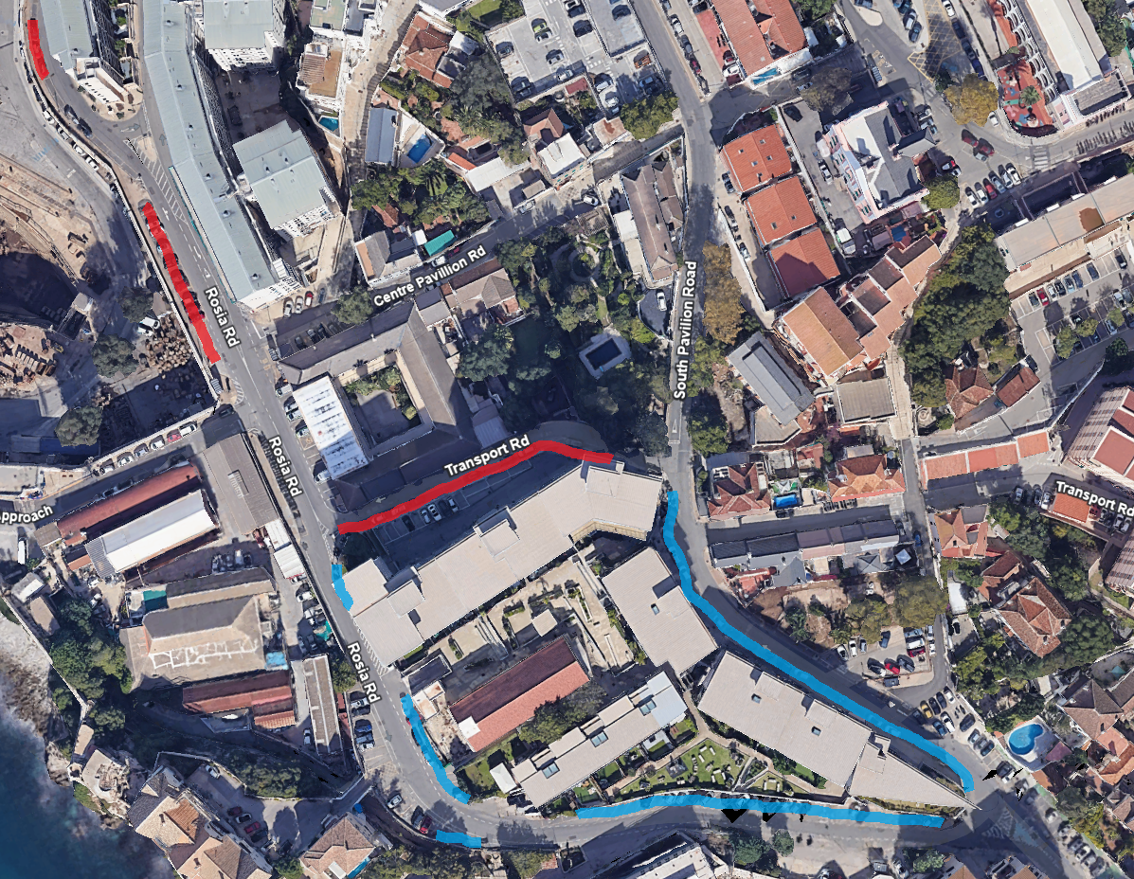
Impacts of Phase 4 – Transport Road
Traffic Flow
TEMPORARY PARKING LOSS
REORIENTATED PARKINGS

Slide 14
Impacts of Phase 4 – Transport Road
Traffic Flow
Parking
Bus Routes

Slide 15
Bus Routes
Impacts of Phase 4 – Transport Road
Temporary bus stop at Bay View Terraces (Rosia Road).
Temporary bus stop at Rosia Plaza.
Suspension of route 4.
Changes to Route 3, 8 and 9.
Improved frequency of buses on route 8 and 9.

Slide 16
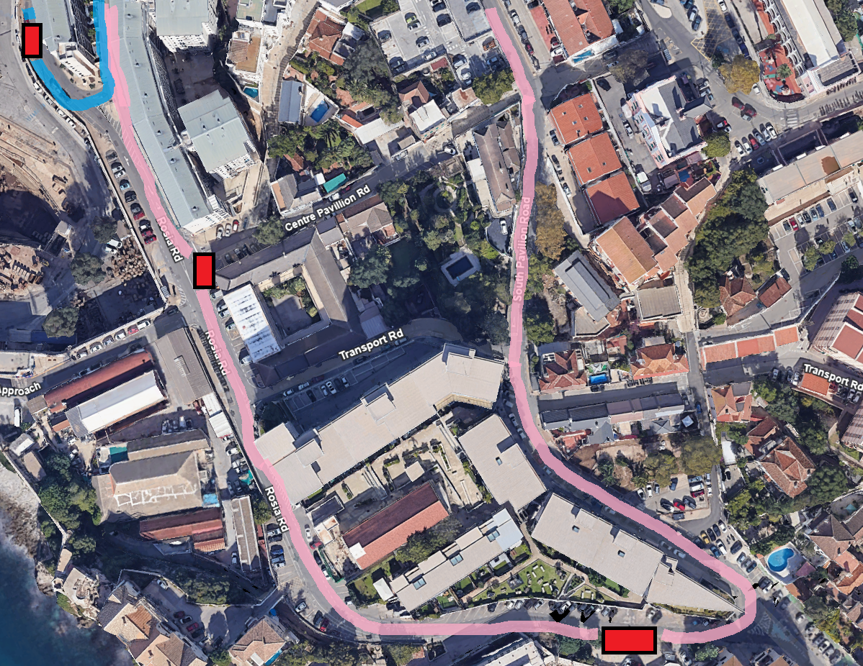
Bus Routes
Impacts of Phase 4 – Transport Road
Bayview (Temp)
ROUTE 3
ROUTE 9
BUS STOP
ROUTE 3
ROUTE 9
BUS STOP
New Mole House
Rosia Plaza (Temp)

Slide 17
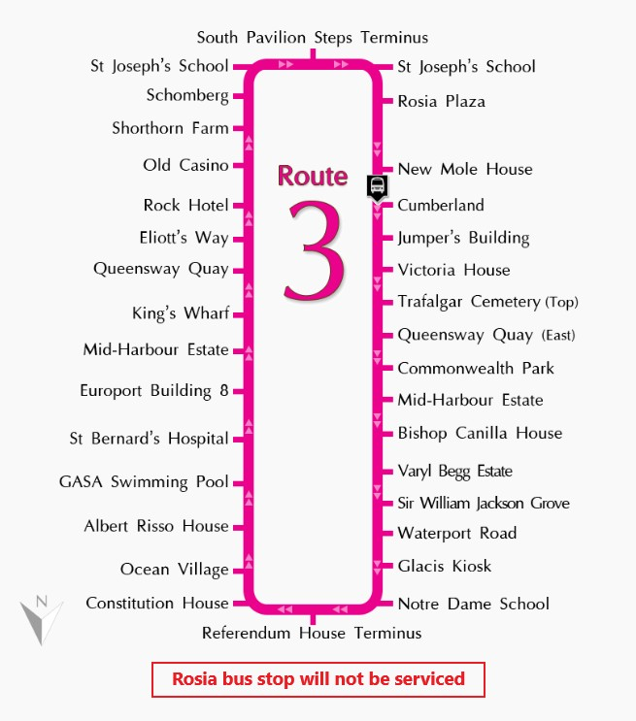
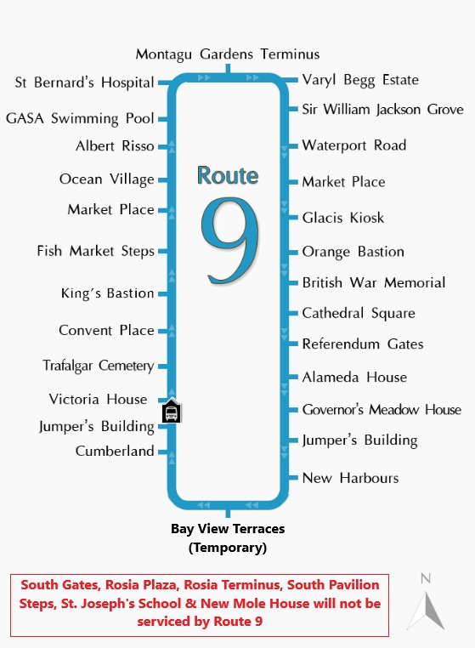
Bus Routes
Impacts of Phase 4 – Transport Road

Slide 18
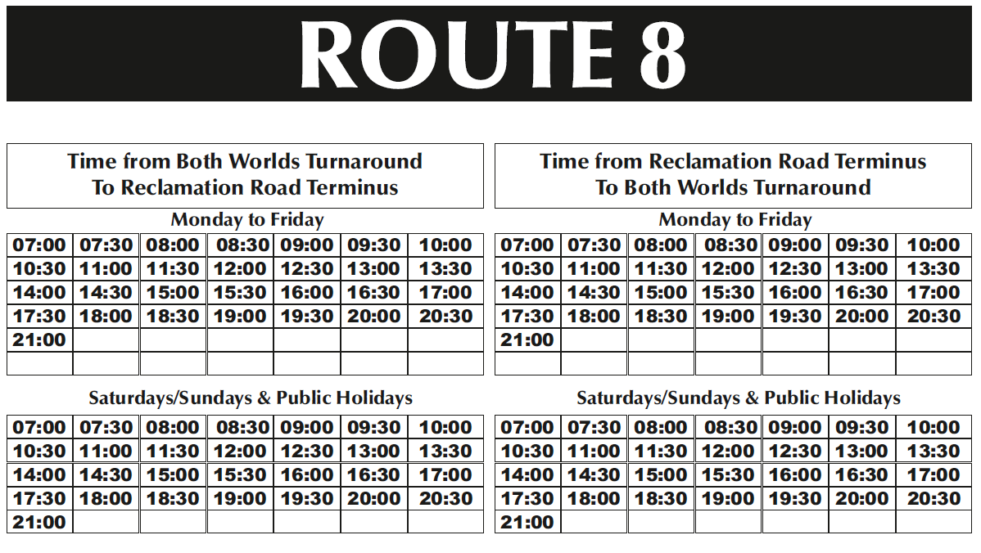
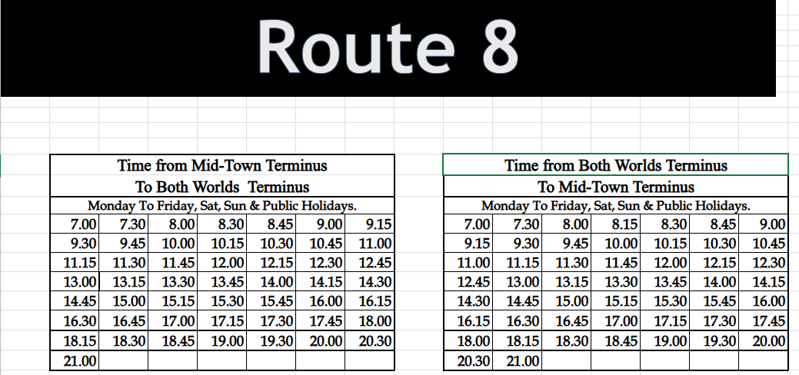
New Bus Timings
Impacts of Phase 4 – Transport Road
OLD
NEW
Buses leave Both Worlds every 15 minutes
due to removal route 4

Slide 19
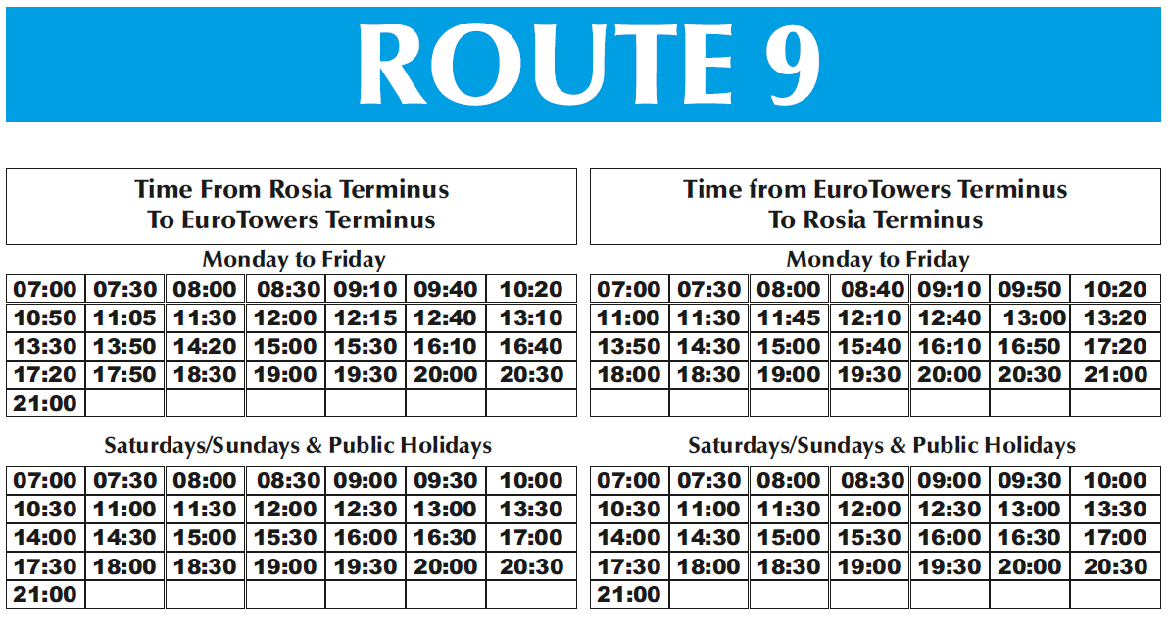
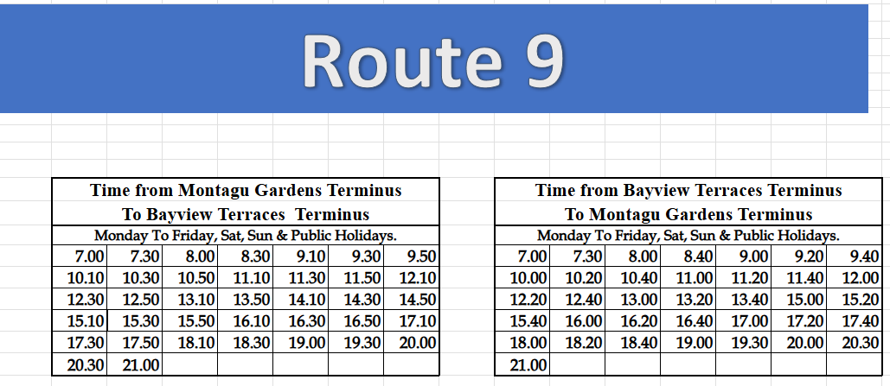
New Bus Timings
Impacts of Phase 4 – Transport Road
OLD
NEW
Buses leave Bayview every 20 minutes due to removal of route 4

Slide 20
