Slide 1
Delivery Drivers
Ministry of Transport – Safety Campaign

Slide 2
Phase 1 – June 2025
Vehicle clearly marked with company logo/name
Delivery Driver Card Issued
PLET definition to be updated to include thrust controlled ebikes as a PLET
Phase 2 –
June 2026
Road side testing of PLETs
Confiscation of PLETs not roadworthy
Driver’s must possess a driver’s license or undergo CBT to carry out deliveries on any vehicle
Introduction of compulsory road safety and food hygiene training
Phase 3 – December 2026
Criteria for Issuing and removal of Delivery Driver card to be formalised requiring record of training and driving license/training to be presented on an annual basis.
Driver clearly marked and numbered
Employer record of unique driver numbers

Slide 3
Phase 1
Legislation to be drafted to ensure all delivery vehicles are clearly marked with company logo, company uniform, unique driver number and visibly show delivery driver card.
Logo on box
Logo on uniform
Delivery Driver Card
Unique Driver Number

Slide 4
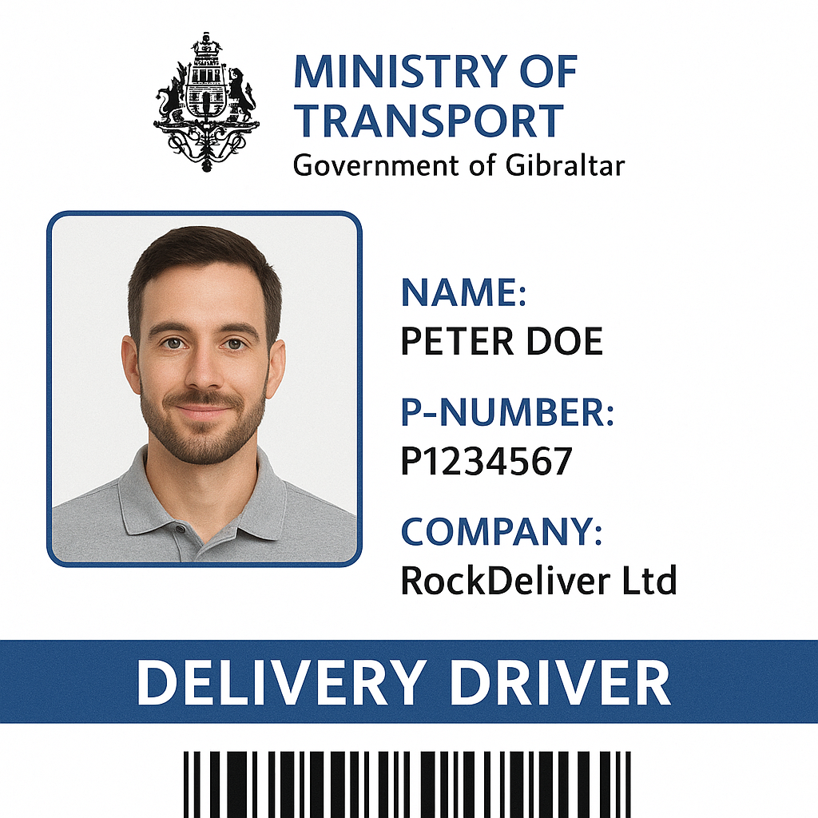
Cards to be produced by Customer Care Hub.
Card will be produced when employment documents and Government issued ID shown to staff.
Green card for those that present driving license or CBT training.
Red card for those that do not.

Slide 5
Penalties for non compliance
Level 2 Fines to driver (£300)
Level 2 Fines to employer (£300) and report to OFT

Slide 6
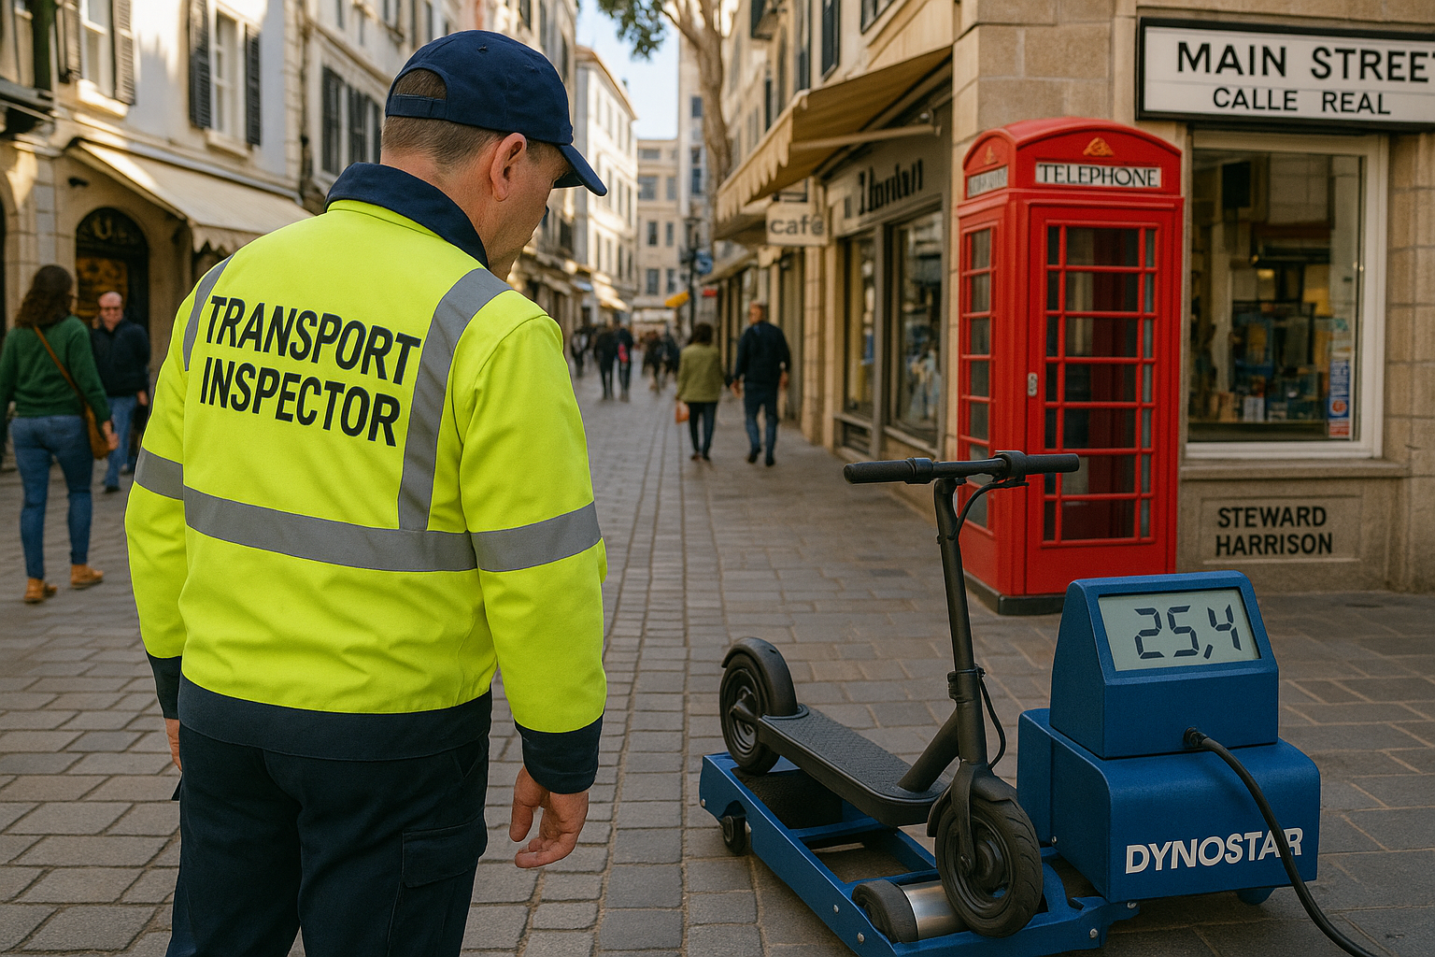
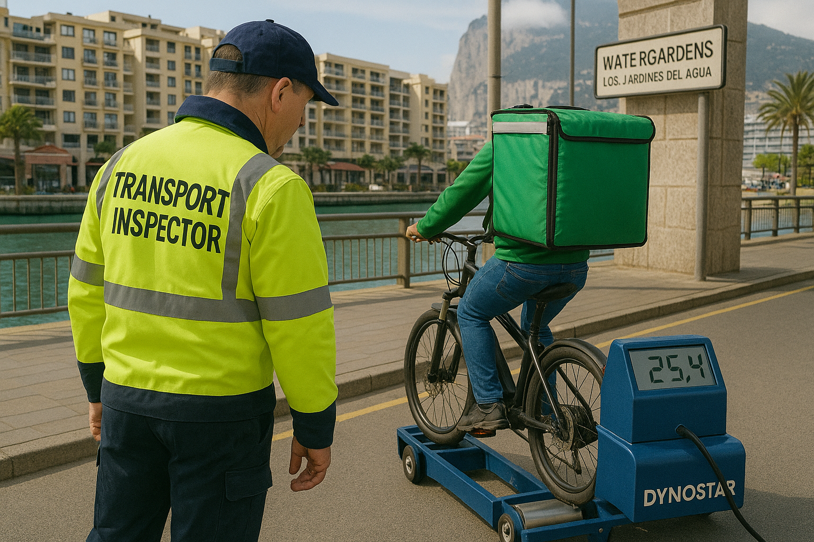
Phase 2
Legislation to be drafted to allow Transport Inspectors to carry out roadside checks on PLETs and confiscate if in breach of minimum standards as set out in Personal Light Electric Transporters Act 2023

Slide 7
Phase 2
Upon annual renewal of card, driver license or CBT certificate to be produced.
Red cards will no longer be recognised and employer will be informed.

Slide 8
Penalties for non compliance
Impound Fees in line with current regulations
FPNs issued to driver and employer for not having up to date Delivery Driver Card.

Slide 9
Phase 3
Upon annual renewal of card, driver license or CBT certificate to be produced along with evidence for completion of road safety and food hygiene training.
Employees who have not completed training will not be issued with green Delivery Driver Card.

Slide 10
Level of Checks and Standards
Phase 1 – June 2025
Employment Status
Formal Identification
Level of road usage training
Phase 2 –
June 2026
Employment Status
Formal Identification
Minimum Driving Competence
Road worthiness for all vehicles
Phase 3 – December 2026
Employment Status
Formal Identification
Minimum Driving Competence
Road worthiness for all Vehicles
Food Hygiene and Road Safety Training

